Slide 1

World Happiness Report Analysis
Data Science Capstone Project

Slide 2
Introduction
Measurements of well-being is used effectively to assess progress of countries. Lately reports on happiness of citizens has been used to guide policy-making decisions in many countries.
This project aims to find correlation between economy, social support, degree of liberation, health, perception of corruption and 'Happiness score' of countries. This will provide valuable insights about main factor leading to happiness as well as unhappiness globally.
This project focuses on happiness at a collective level which will suggest areas where the government can step in and help improve happiness of its citizens.

Slide 3
Data Description
The World Happiness Report 2020 ranks 153 countries by their happiness levels. The happiness scores and rankings use data from the Gallup World Poll.
The scores are based on answers to the main life evaluation question asked in the poll.
The columns following the happiness score estimate the extent to which each of six factors – economic production, social support, life expectancy, freedom, absence of corruption, and generosity – contribute to making life evaluations higher in each country.

Slide 4
Data
Column Name | Column Description
Country | Name of country
Regional indicator | Region where the country belongs
Happiness score | A metric measured by asking the sampled people the question: "How would you rate your happiness on a scale of 0 to 10 where 10 is the happiest."
Logged GDP per capita | The extent to which GDP contributes to the calculation of the Happiness Score
Social support | The extent to which Family and friends contribute to the calculation of the Happiness Score
Healthy life expectancy | The extent to which Life expectancy contributed to the calculation of the Happiness Score
Freedom to make life choices | The extent to which Freedom contributed to the calculation of the Happiness Score
Generosity | The extent to which generosity of people contributed to the calculation of the Happiness Score
Perceptions of corruption | The extent to which Perception of Corruption contributes to Happiness Score

Slide 5

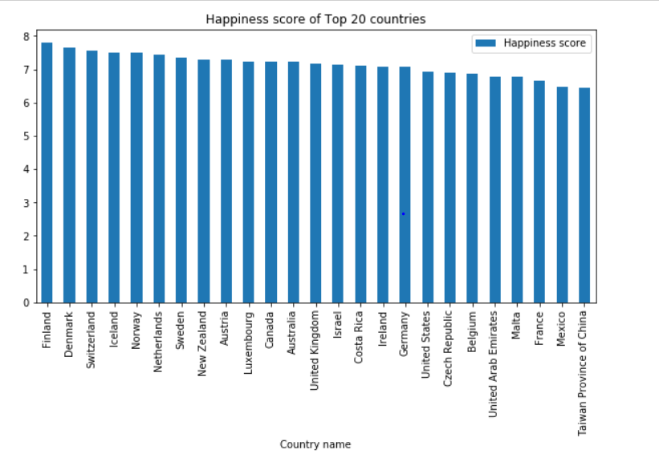

Happiness score of Different Countries
This represents the Happiness scores of top 20 countries. The happiness scores of these countries range closely between 6 and 8.

Slide 6
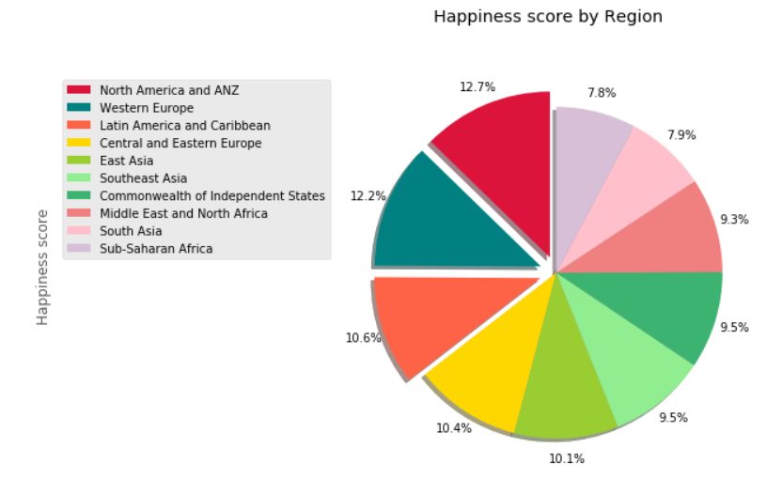
Happiness score by Region
This represents the Happiness scores by region of the 153 countries with the highest being for North America and ANZ, Western Europe, Latin America and Caribbean.

Slide 7
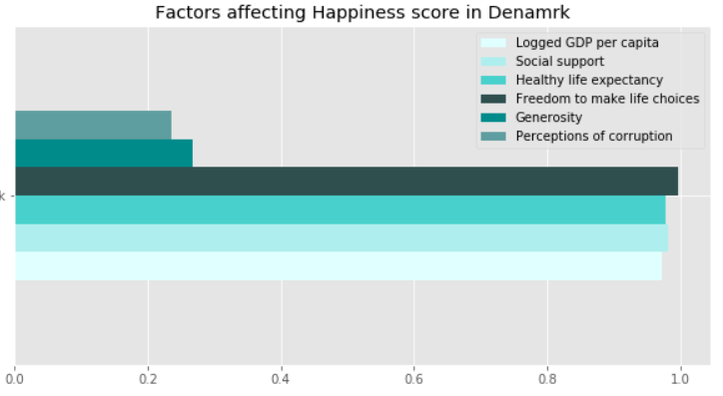
Factors affecting Happiness score in Denmark
This shows the degree in which the six factors considered affect the happiness score in a country with a high happiness score.
Freedom to make life choices and social support affect the happiness score the most.

Slide 8
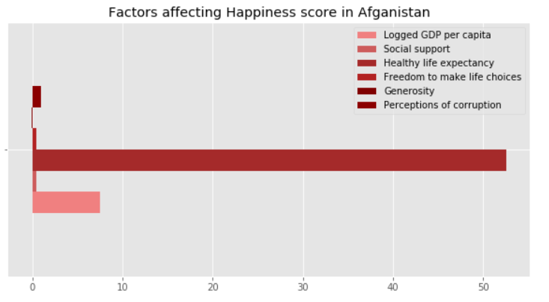
Factors affecting Happiness score in Afghanistan
This shows the degree in which the six factors considered affect the happiness score in a country with least happiness score.
Healthy life expectancy affects the happiness score the least.

Slide 9
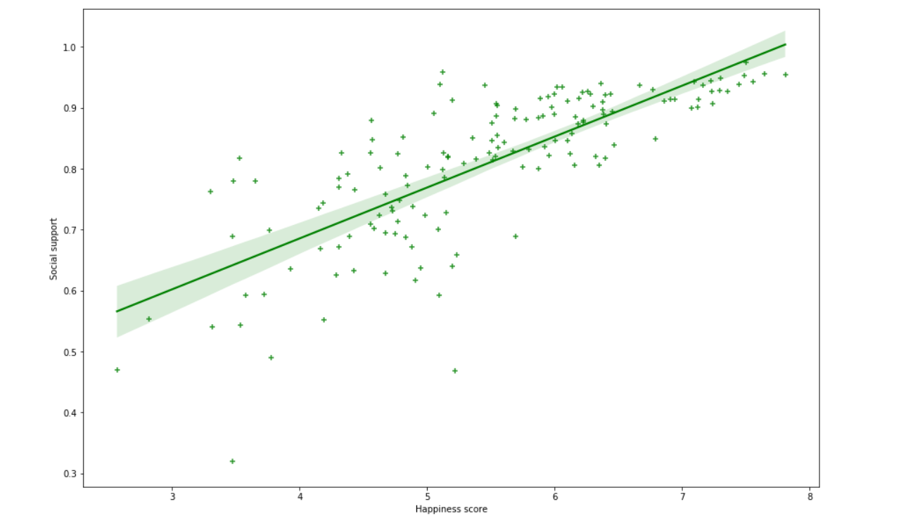
Happiness score & Social support
This shows the relationship between Happiness score and the factor that affects it the most ‘Social support’.
The Happiness score is positively correlated to Social support.

Slide 10
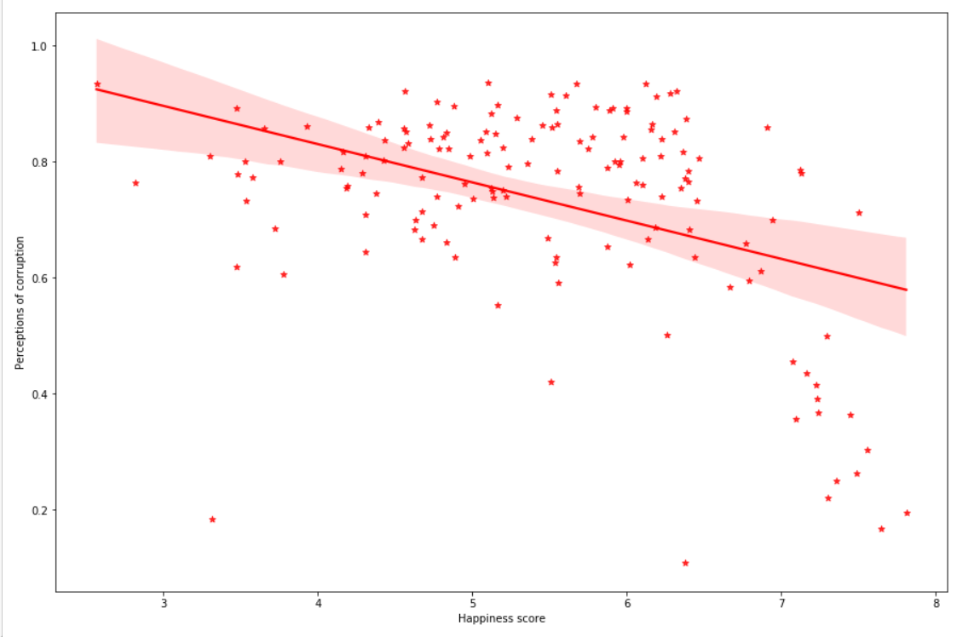
Happiness score & Perceptions of corruption
This shows the relationship between Happiness score and the factor that affects it the least ‘Perceptions of corruption’.
Happiness score is negatively correlated to Perceptions of corruption.

Slide 11
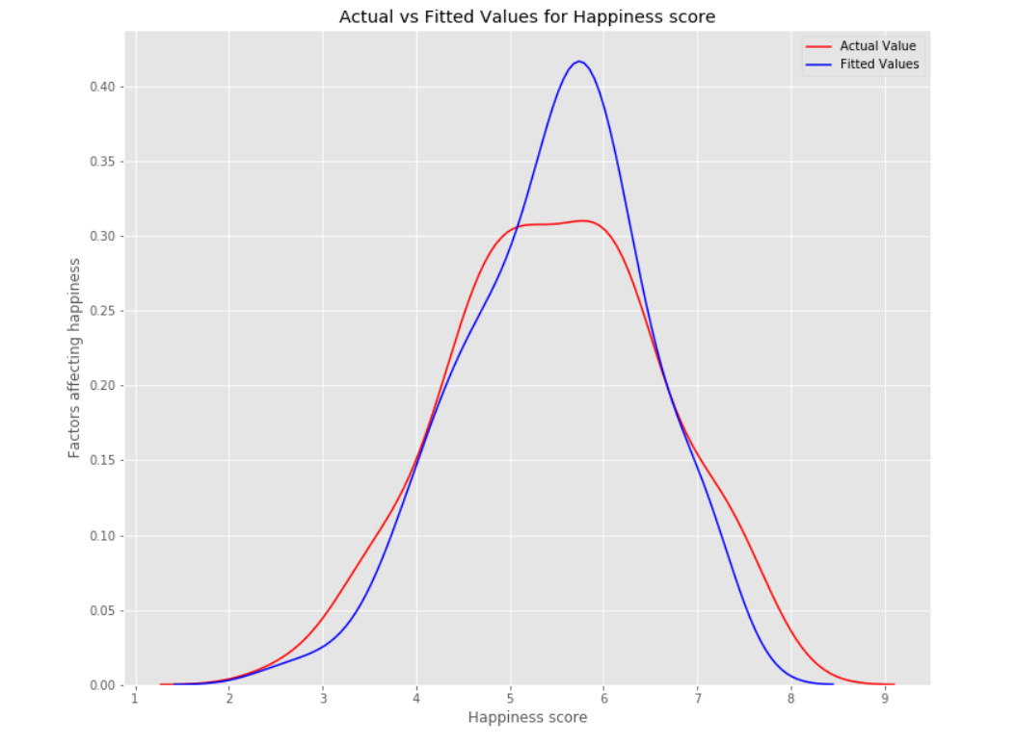
Multiple Linear Regression Model
value of the intercept=-2.05937726
Values of coefficients: array([0.229, 2.7233, 0.035, 1.776, 0.410, -0.628])
The R-squared value=0.74833231
We can see that the fitted values are reasonably close to the actual values, since the two distributions overlap a bit.

Slide 12
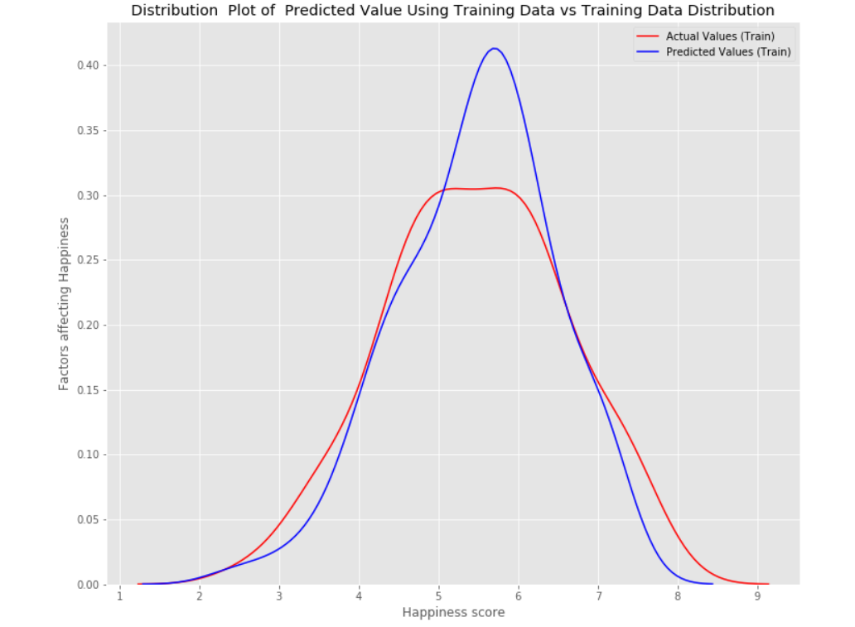
Model Evaluation
Plot of predicted values using the training data compared to actual training data.

Slide 13
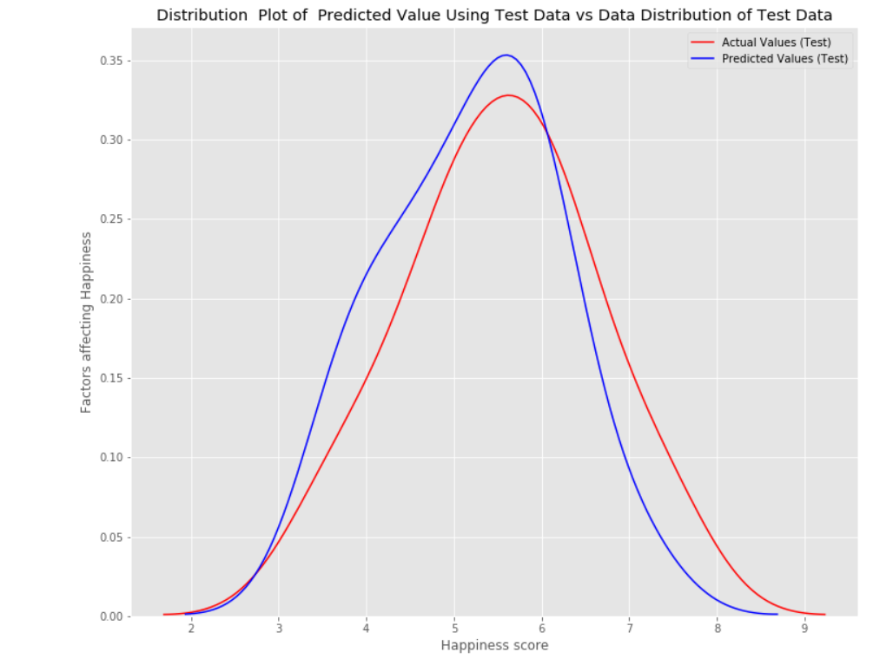
Model Evaluation
Plot of predicted values using the test data compared to actual test data.

Slide 14
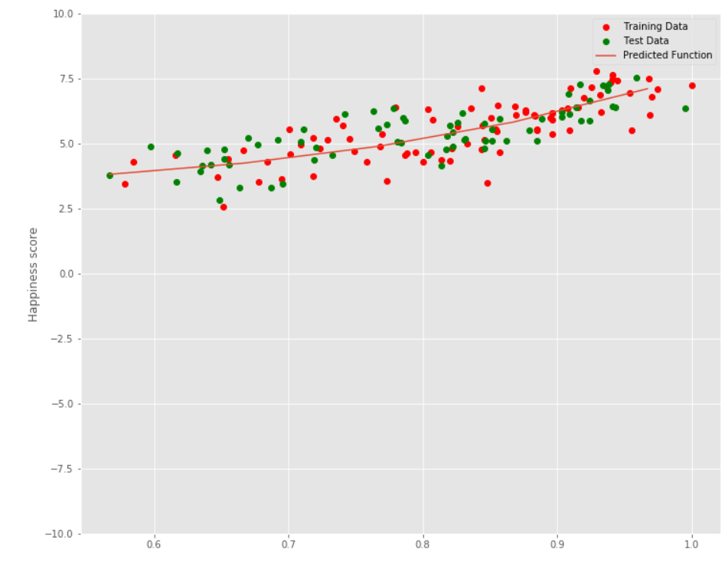
Polynomial Regression Model
As the plot is neither over-fitting nor under-fitting, the model fits the data.

Slide 15
Observations
North America, Australia & New Zealand are the regions with highest Happiness scores.
Freedom to make life choices and social support affect the happiness score the most.
Healthy life expectancy affects the happiness score the least.
The Happiness score is positively correlated to Social support & negatively correlated to Perceptions of corruption.

Slide 16
Conclusion
Analyzing the World Happiness Report 2020 has provided insights about how social support and liberation in a country increases happiness of its citizens. This might be helpful for governments to consider these factors while making policy-decisions eventually leading to well-being of all.

